Slide 1
CONTENTS
Design Metrics

Slide 2
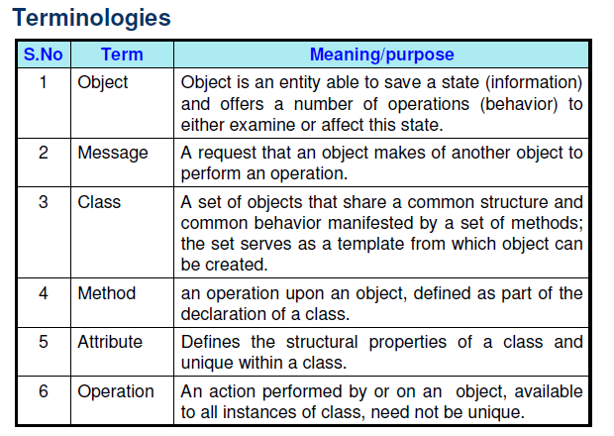
Object Oriented Metrics

Slide 3
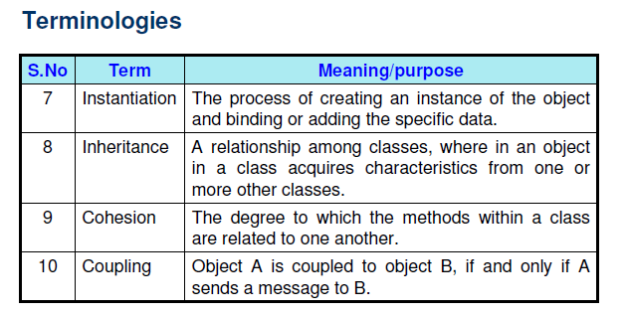

Slide 4
• Measuring on class level
– coupling
– inheritance
– methods
– attributes
– cohesion
• Measuring on system level

Slide 5
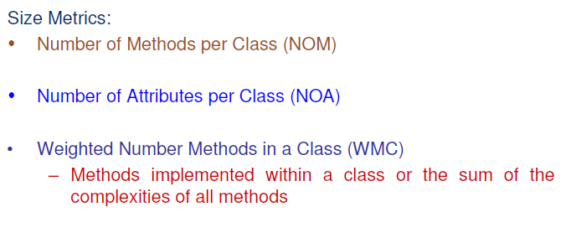

Slide 6
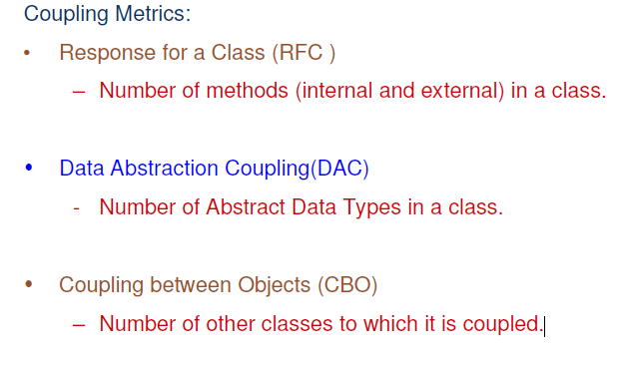

Slide 7
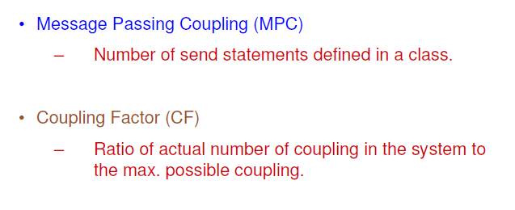

Slide 8
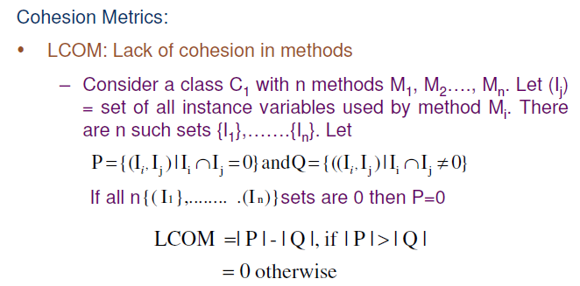

Slide 9
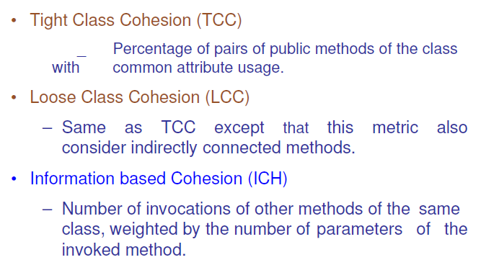

Slide 10
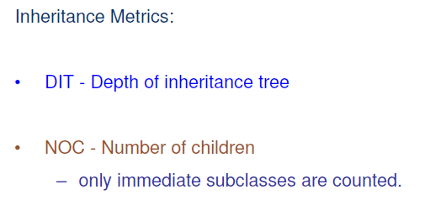

Slide 11
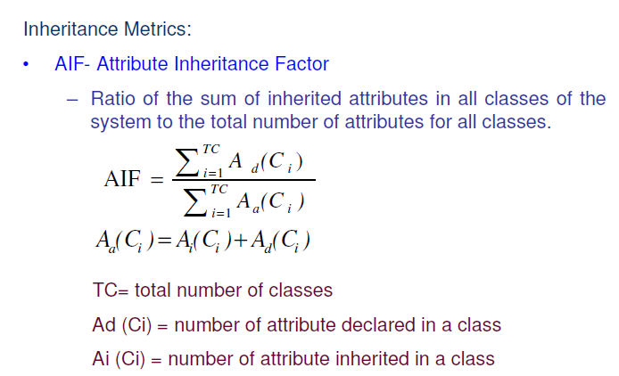

Slide 12
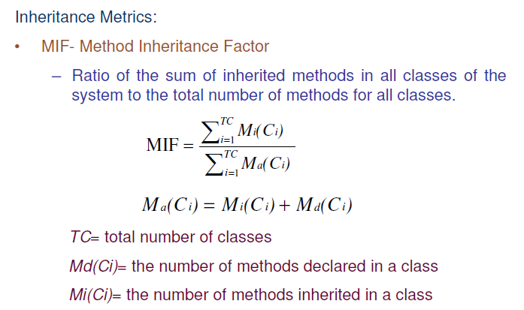

Slide 13
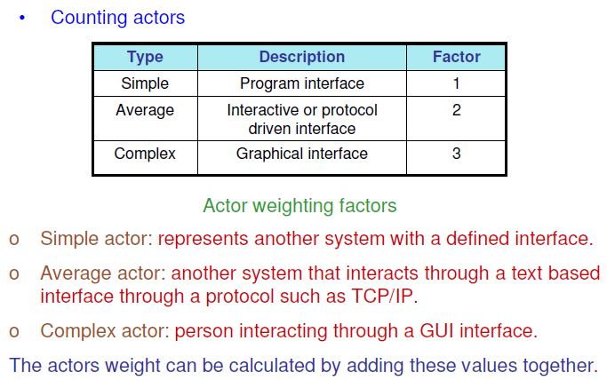
Use-Case Oriented Metrics

Slide 14
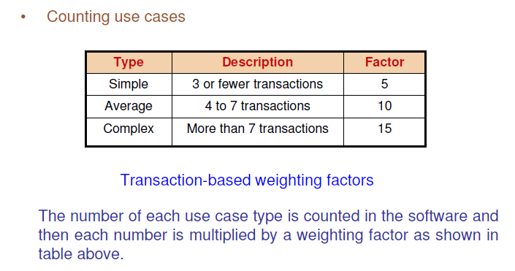

Slide 15
QUESTIONS
Q-1. Discuss the object oriented metrics?
Q-2. What is the importance of metrics in object oriented software development ?
Q-3. What is the significance of use case metrics? Is it really important to design such
metrics?
Q-4. Define the following: RFC, CBO, DAC, TCC, LCC & DIT.
Q-5. Explain terms cohesion and coupling?

Slide 16
THANK YOU

